Slide 1



School of Information Technology
https://www.monash.edu.my/
FIT5226
Multi-agent System & Collective Behaviour
Week 4-2: Deep Reinforcement and Deep-Q
FIT5226 S2 2024
Prepared by: Bernd Meyer. Edited by: Fuad Noman
www.monash.edu.au

Slide 2
Acknowledgments
This material includes content adapted from instructional resources made available by David Silver as part of his Reinforcement Learning course at UCL under CC-BY-NC 4.0.
Refer to https://www.davidsilver.uk/teaching/ for full details
You may refer to Chapter 6,
Enes Bilgin - Mastering Reinforcement Learning with Python (2020)
FIT5226 S2 2024
Week-5

Slide 3
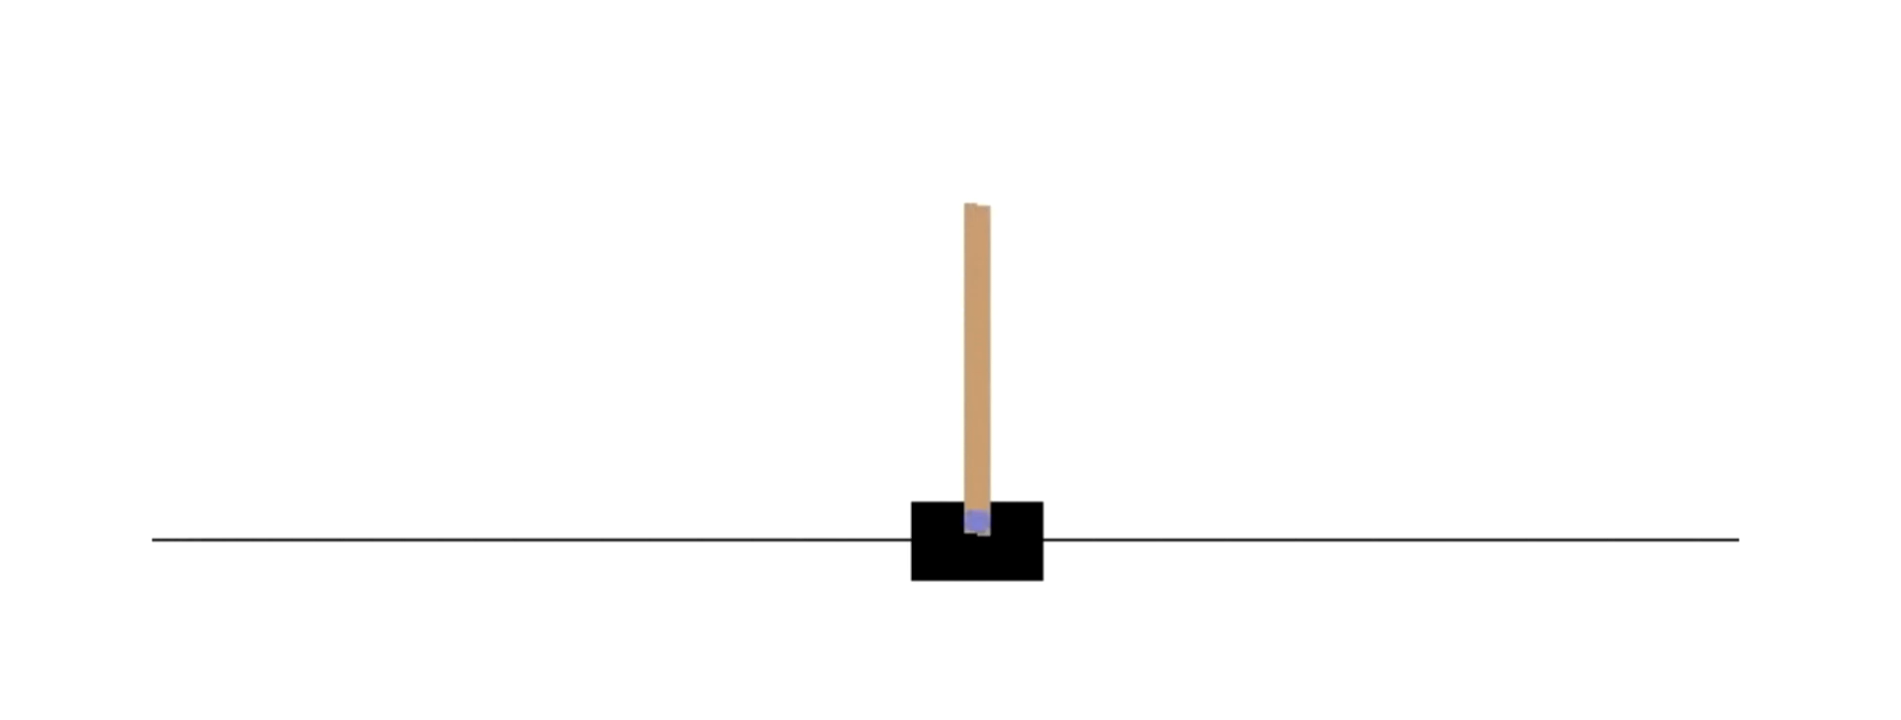
The Cart Pole Problem
cart pole or inverted pendulum
FIT5226 S2 2024
Week-5
Notes:
CartPole, also known as inverted pendulum, is a game in which you try to balance the pole as long as possible. It is assumed that at the tip of the pole, there is an object which makes it unstable and very likely to fall over.

Slide 4
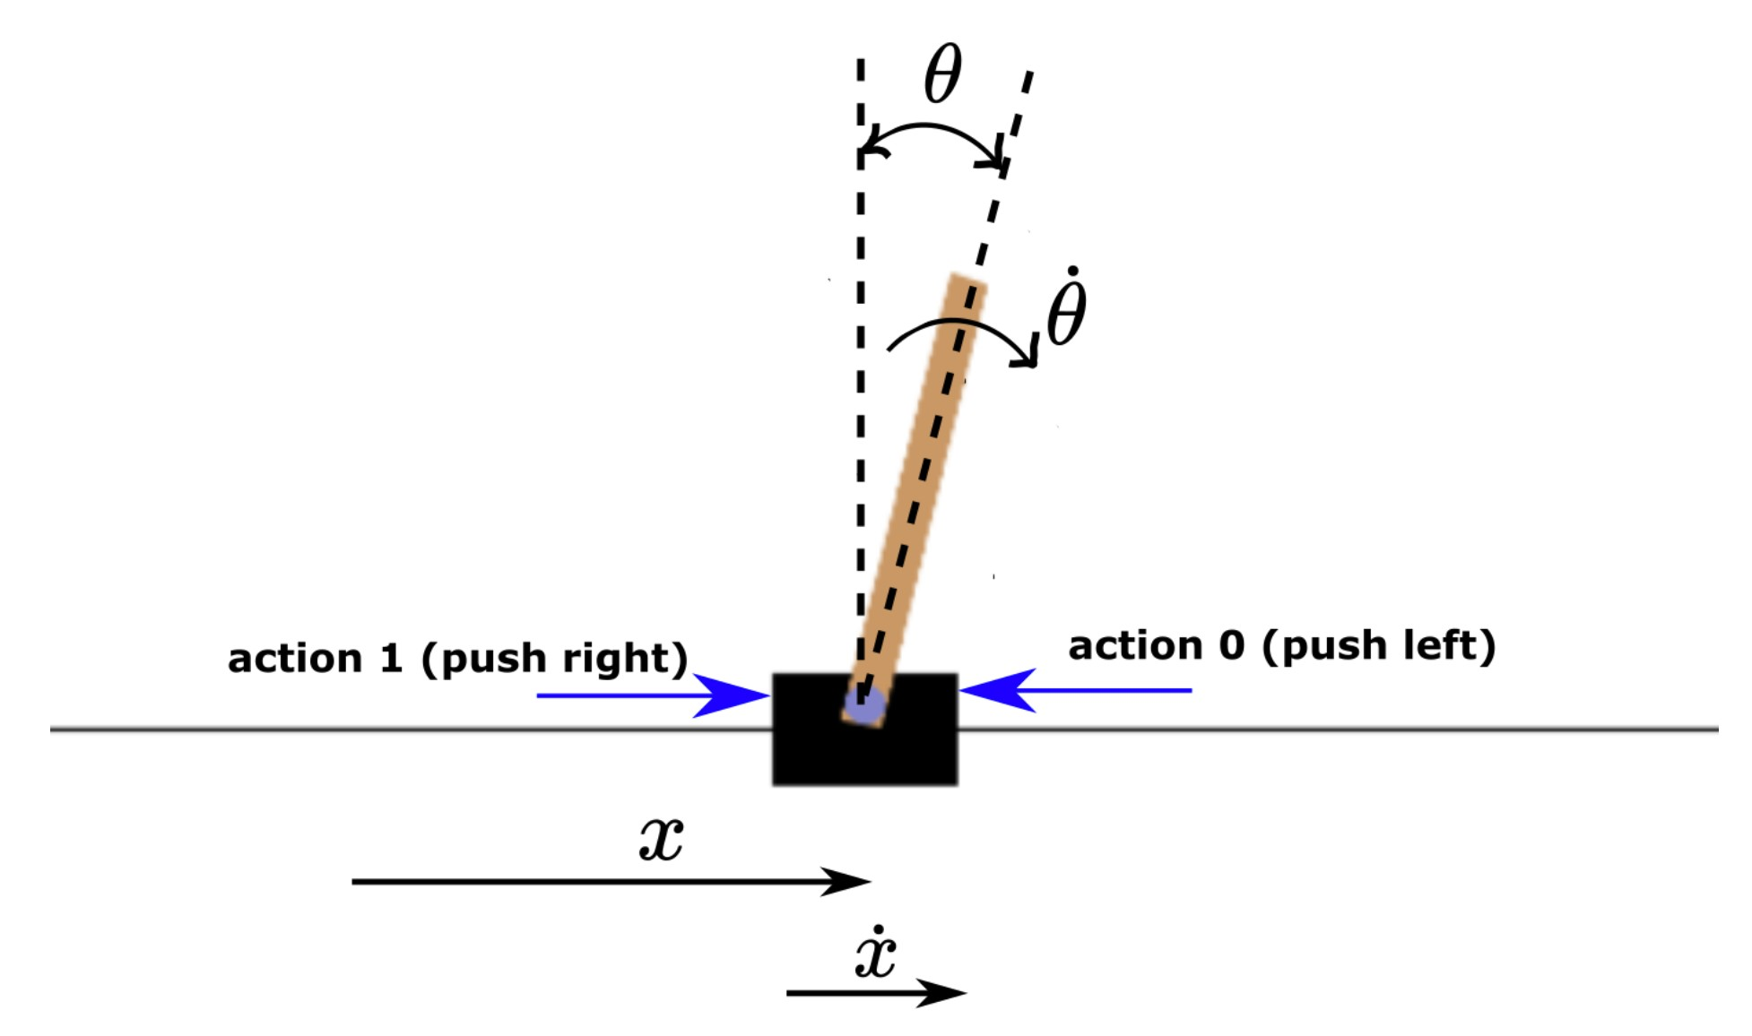
Continuous State Spaces
Observation (state) space
•
•
•
•
Cart Position (x): The horizontal position of the cart on the track. Cart Velocity (dx/dt): The velocity of the cart.
Pole Angle (θ): The angle of the pole from the vertical upright position. Pole Angular Velocity (dθ/dt): The angular velocity of the pole.
FIT5226 S2 2024
Week-5

Slide 5
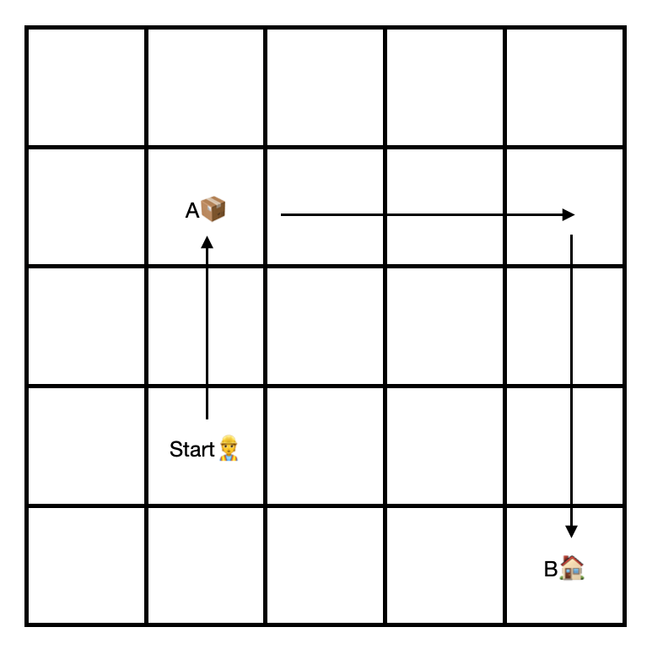
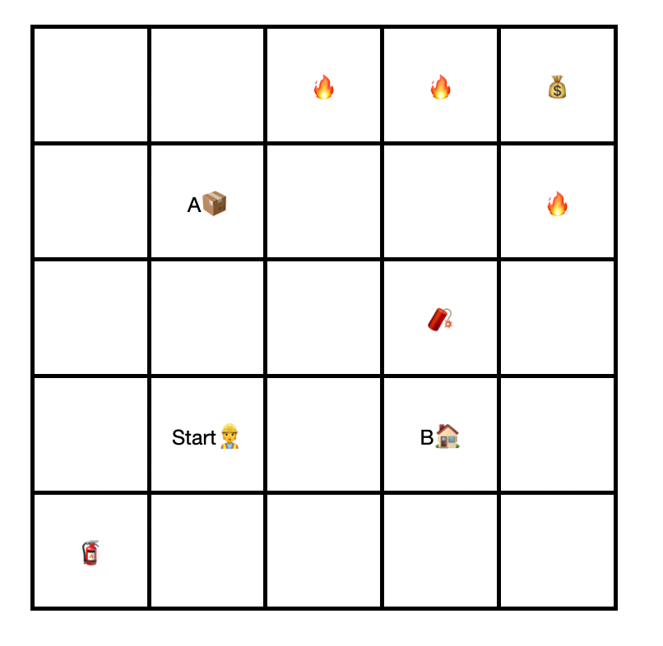
State Space Size
≈ 25² = 625
≈ 25⁹ = 3,814,697,265,625
Backgammon: 10²⁰; Go: 10¹⁷⁰
FIT5226 S2 2024
Week-5
Notes:
The state space size problem arises when the number of possible states is very large or even infinite. As the state space grows it becomes increasingly challenging to explore and learn forms every state. Traditional methods like tabular Q-learning struggle in high dimensional state space due to the “curse of dimensionality” where the amount of data required to accurately represent and learn from the space becomes impractical.

Slide 6
Generalisation in more complex state spaces
Mars rover must learn high-level control to traverse terrain
Driving over hazardous terrain 10x slower
4 actions
Distance sensor
Terrain sensor
4 | 3 | 2 | 1
3 | 2 | 1 | G
S | 3 | 2 | 1
-1 | -1 | -10 | -10
-1 | -1 | -1 | -1
-1 | -10 | -1 | -10
FIT5226 S2 2024
Week-5

Slide 7
State Space for Mars Rover
State space is a vector of features
𝑠 = (𝐷_{𝑁}, 𝐷_{𝐸}, 𝐷_{𝑆}, 𝐷_{𝑊} , 𝐻_{𝑁}, 𝐻_{𝐸}, 𝐻_{𝑆}, 𝐻_{𝑊})
𝑠 = (3, 2, 3, 4, 0, 1, 0, 0)
Suppose:
Max distance 5 with Boolean hazard sensor,
Then, |𝑠|= 5⁴ + 2⁴ = 10,000 states, |A| = 4 actions,
40,000 Q-table entries, about 157 kB of memory
FIT5226 S2 2024
Week-5
Notes:
5 distances (0,1,2,3,4)
Boolean hazard sensor (hazard present / no hazard)
5^4: means the distance from current state to the 4 neighboring squares/states.

Slide 8
Generalisation
After some exploration, our rover learned to navigate safely
Now we change the map:
-1 | -1 | -10 | -10
-1 | -1 | -1 | G
S | -10 | -1 | -10
-1 | -1 | -1 | -10
-1 | -10 | -1 | G
S | -10 | -1 | -10
What will happen?
FIT5226 S2 2024
Week-5

Slide 9
Value Function Approximation
Very large state spaces
Continuous state spaces
Need for generalisation
➡ use a value function instead of a value table
of course, this can only be an approximate
FIT5226 S2 2024
Week-5
Notes:
Instead of using a table, we are using a function, which will allow us to deal with continuous values.

Slide 10
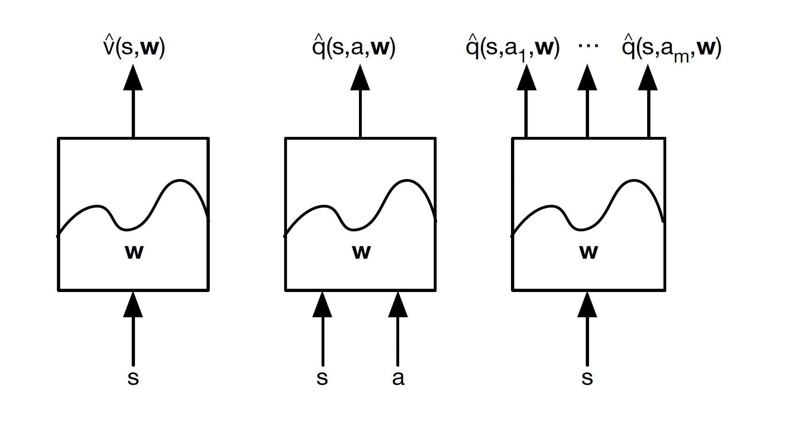
Value Function Approximation Types
F : S → ℝ
F : S × A → ℝ
F : S → A × ℝ
FIT5226 S2 2024
Week-5
Notes:
Left: from week-2, Value function approximation (given state as input, estimate the state values)
Middle: from week-3, to get ultimate control, we need the state-active value function, where given state and action, we estimate the q value (single value) for that state and action. Which is exactly what we did in Q-learning.
Right: it is a variation of the Middle function, where we only have state as input, and we estimate all q values (not single value) for all possible actions in that state.

Slide 11
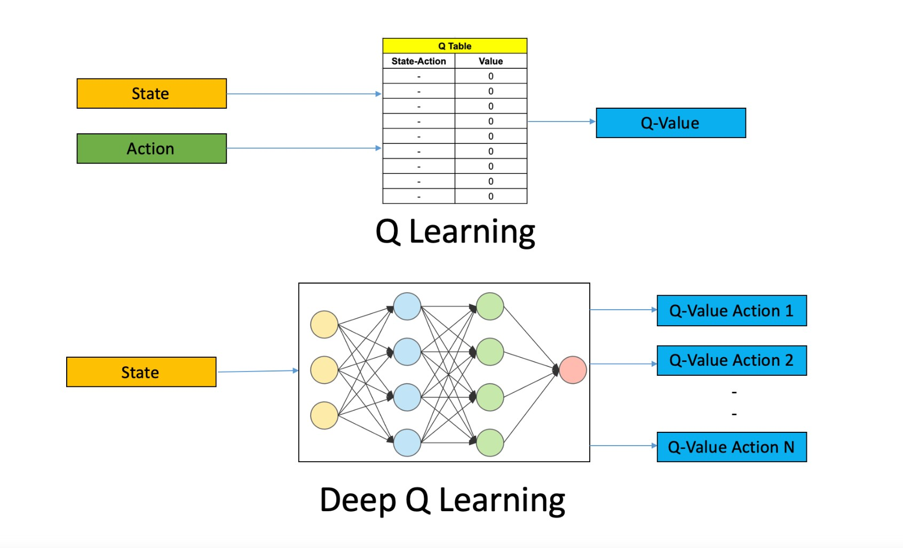
Value Function Approximation with Deep-Q Network
…
…
…
…
from: https://www.analyticsvidhya.com/blog/2019/04/introduction-deep-q-learning-python/
FIT5226 S2 2024
Week-5

Slide 12
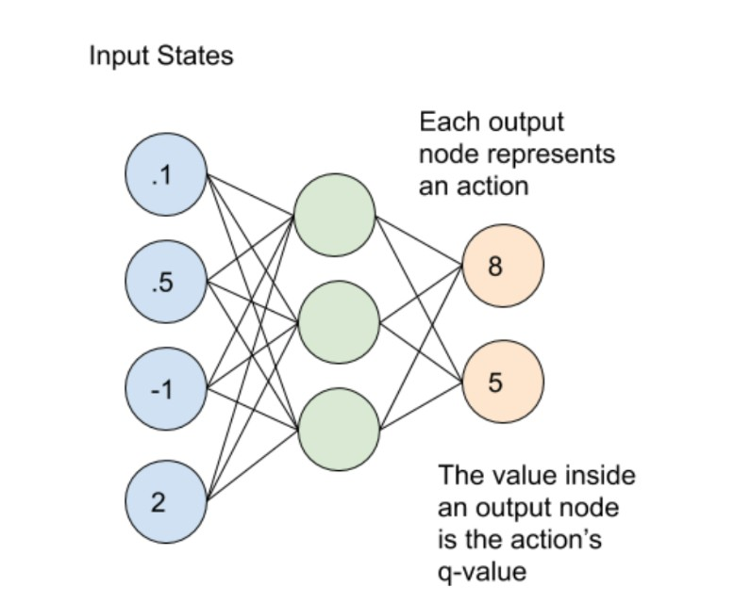
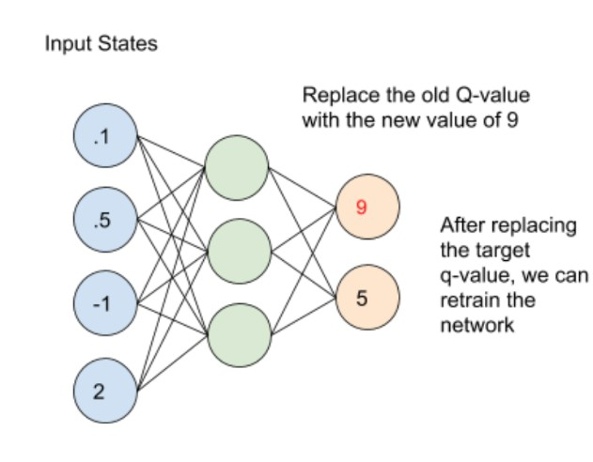
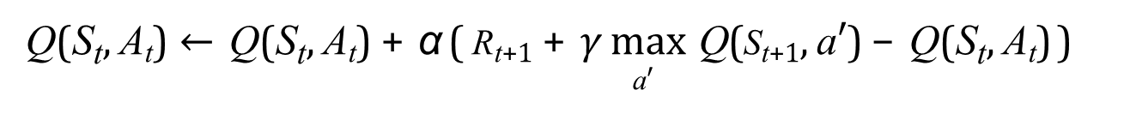
From Bellman Update to Loss Function
Q(S_{t}, A_{t}) ← Q(S_{t}, A_{t}) + α ( R_{t+1} + $γ$ max Q(S_{t+1}, a′) − Q(S_{t}, A_{t}))
a′
TD-target
Notes:
The expression you provided is the Bellman update equation for Q-learning, a key concept in reinforcement learning. Here's a breakdown of the equation:
Bellman Update Equation:
$$Q\left(S_{t}, A_{t}\right)←Q\left(S_{t}, A_{t}\right)+ α\left.\left( R_{\left\{t+1\right\}}+γ \max_{a^{′}} Q\left(S_{\left\{t+1\right\}}, a^{′}\right)− Q\left(S_{t}, A_{t}\right)\right.\right)$$
- $( Q\left(S_{t}, A_{t}\right))$: The current estimate of the Q-value for taking action $( A_{t})$in state $( S_{t}).$
- $( α)$: The learning rate, which determines how much new information overrides the old information.
- $( R_{\left\{t+1\right\}})$: The reward received after taking action $( A_{t})$in state$( S_{t}).$
- $( γ)$: The discount factor, which determines the importance of future rewards.
- $\max_{a^{′}} Q\left(S_{\left\{t+1\right\}}, a^{′}\right)$: The maximum estimated Q-value for the next state $( S_{\left\{t+1\right\})},$considering all possible actions $( a^{′}).$
- $( Q\left(S_{t}, A_{t}\right))$: Subtracted to calculate the temporal difference (TD) error.
From Bellman Update to Loss Function:
The Bellman update can be interpreted as minimizing the temporal difference (TD) error. This can be formulated as a loss function in the context of training a Q-function approximator (e.g., a neural network).
TD Loss Function:
To turn the Bellman update into a loss function, you can define the TD error and then square it to penalize larger errors:
$$TD Error= \left.\left( R_{\left\{t+1\right\}}+γ \max_{a^{′}} Q\left(S_{\left\{t+1\right\}}, a^{′}\right)− Q\left(S_{t}, A_{t}\right)\right.\right)$$
The loss function to minimize during training would then be:
$$ℒ=\frac{1}{2} {\left(TD Error\right)}^{2}$$
Substituting the TD Error, the loss function becomes:
$$ℒ=\frac{1}{2}{\left.\left( R_{\left\{t+1\right\}}+γ \max_{a^{′}} Q\left(S_{\left\{t+1\right\}}, a^{′}\right)− Q\left(S_{t}, A_{t}\right)\right.\right)}^{2}$$
This loss function is often used to update the parameters of a Q-function approximator, like a neural network, in deep Q-learning algorithms. The goal is to minimize the difference between the current Q-value estimate and the target value derived from the Bellman equation.

Slide 13
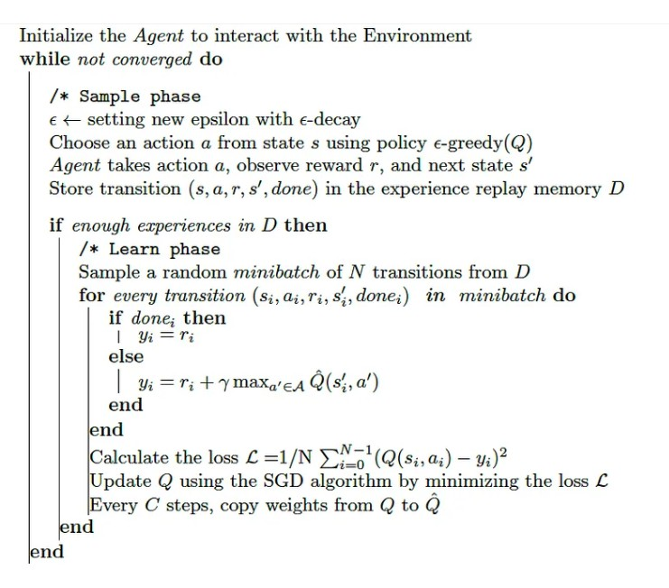
DQN Algorithm
Chapter 6, pages 197-198, Mastering Reinforcement Learning with Python (2020)
Notes:
Initialize $θ$ and a policy, $π$.
Collect a set of $N$ samples, $\{(s_{i}, a_{i}, r_{i}, s_{i}^{′}) |i = 1, … , N\}$, using the 𝜋 policy.
Apply the sampled Bellman optimality operator to obtain the target values, $yi = ri + γ \max_{a_{i}^{′}}{Qθ(si′, ai′)}$, to all samples, 𝑖 = 1, … , 𝑁 , but if $s_{i}^{′}$is a terminal state, set $y_{i} = r_{i}$.
Obtain 𝜃 by minimizing the gap between $Q_{θ}$ and the target values. More formally, $θ ≔arg\min_{θ}{\sum_{i=1}^{N}{L\left(Q_{θ}\left(s_{i}, a_{i}\right), y_{i}\right)}}$, where 𝐿 is a loss function, such as squared error, $\frac{1}{2}{\left(Q_{θ}\left(s_{i}, a_{i}\right)−y_{i}\right)}^{2}$,
Update 𝜋 with respect to the new $Q_{θ}$ value.

Slide 14
Experience Replay
Equivalent to standard Q-learning: adapt the network for every action as it is performed (usually using a single SDG step and MSE loss)
This can be unstable. To stabilise we perform Experience Replay
All Transitions (state, action, reward, new state) are stored in a ring buffer of limited size
Instead of just using the least action for each training step we use a mini-batch to update
randomly sample a mini-batch from the buffer
compute loss and back-propagate for the whole mini-batch
we may do this only every k actions
Note that this if off-policy
(and thus requires an off-policy base algorithm like Q-learning)
FIT5226 S2 2024
Week-5

Slide 15
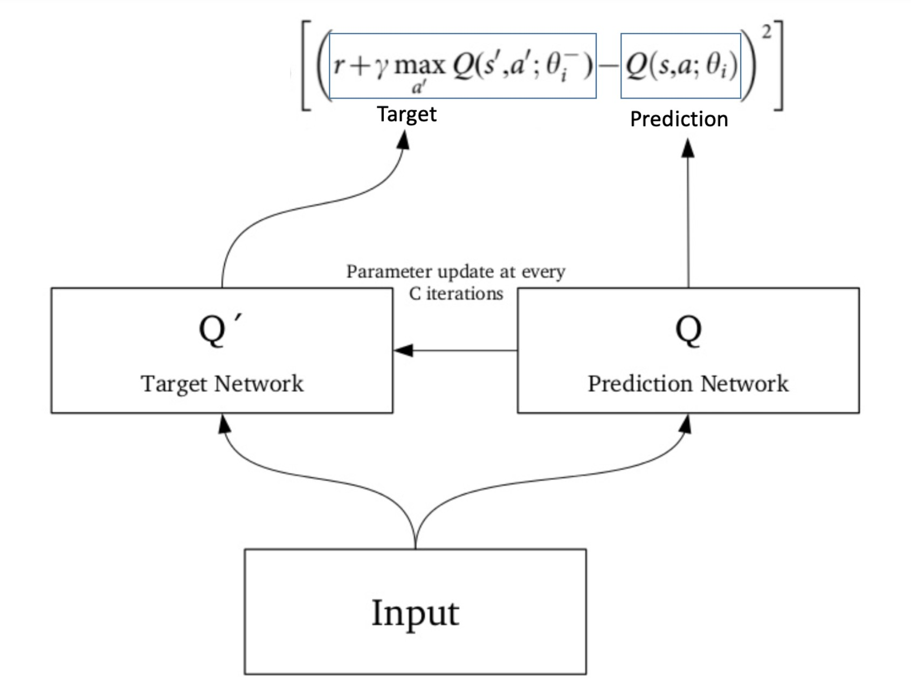
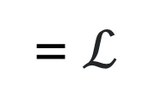
Target Network versus Prediction (main) network
= $ℒ$
from: https://www.analyticsvidhya.com/blog/2019/04/introduction-deep-q-learning-python/
FIT5226 S2 2024
Week-5

Slide 16
Noisy-fying the state
Discrete states (e.g. in grid wolds) can lead to “Dead Neurons”
A trick to avoid this is to add a small amount of noise to the states
This problem occurs specifically with ReLU (rectified linear unit) activation functions since these are non-differentiable at zero when the state vector is sparse (i.e. most its elements are zero) as is the case, for example, in our grid worlds in the lab.
FIT5226 S2 2024
Week-5
Notes:
When you use ReLU activation functions in a neural network for reinforcement learning and encounter a sparse state vector (where most of the elements are zeros), a problem arises. ReLU functions are non-differentiable at zero. This means that the derivative of the ReLU function is undefined at zero, causing issues when calculating gradients through these points during backpropagation.
In reinforcement learning, the neural network learns to make decisions based on the state input it receives from the environment. If the state vector is sparse and contains many zeros, ReLU activations can lead to "dead" neurons. A "dead" neuron is one that always outputs zero, regardless of its input. When this happens, the gradient of the loss function with respect to the network's weights becomes zero for that neuron. Consequently, the weights associated with that neuron don't get updated, and the network doesn't learn from that particular input feature.
To address this, researchers often use variations of ReLU, such as Leaky ReLU or Parametric ReLU, which introduce a small slope for negative inputs to ensure differentiability even at zero. These variations mitigate the vanishing gradient problem and help the network learn effectively even with sparse state vectors and non-differentiable points like zero.

Slide 17
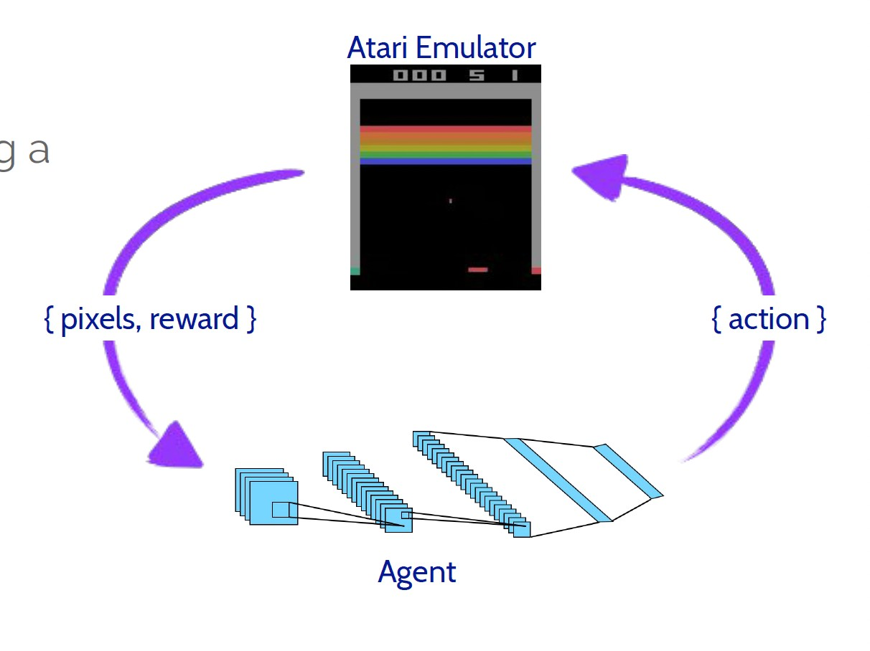

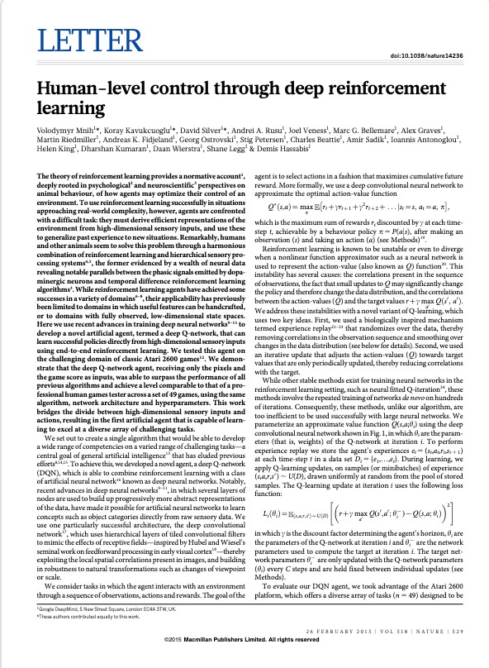
End-to-end State Spaces
FIT5226 S2 2024
Week-5

Slide 18
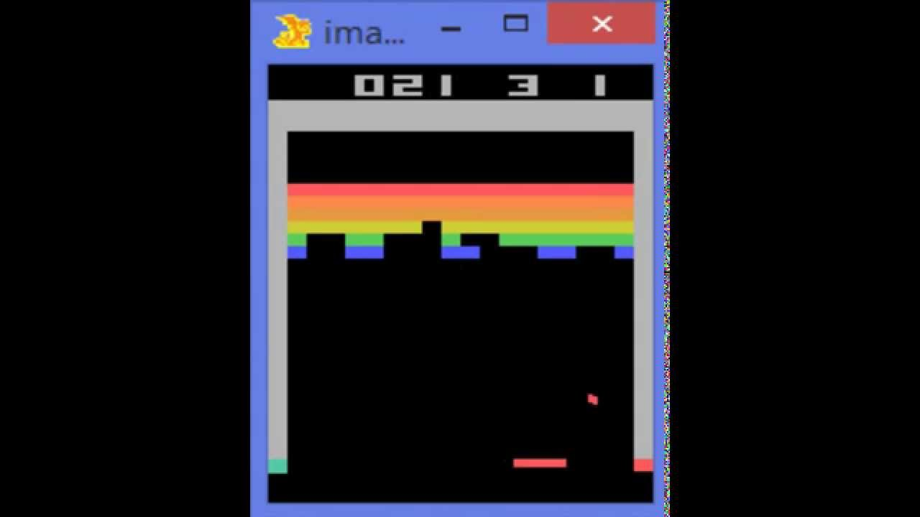

Breakout (DeepMind)
Paper:: dqn.pdf (toronto.edu)
Code: GitHub - drVlasov/Breakout
Explained: (265) Playing Atari Breakout with Deep Reinforcement Learning – YouTube

Slide 19
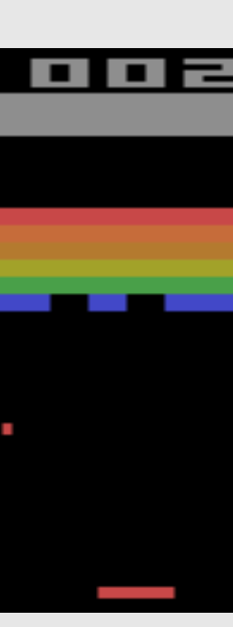
Image Feature Vectors
RED | GREEN | BLUE
0 | 0 | 0
255 | 255 | 255
0 | 0 | 0
210 | 210 | 0
0 | 0 | 0
210 | 210 | 0
0 | 0 | 0
FIT5226 S2 2024
Week-5

Slide 20
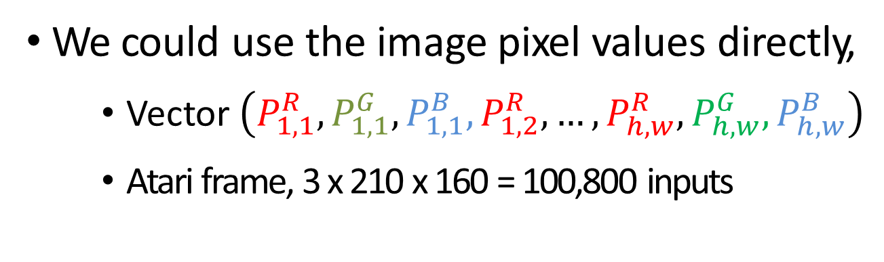
State space for Atari Games
We could use the image pixel values directly,
Vector $\left(P_{1,1}^{R},P_{1,1}^{G},P_{1,1}^{B},P_{1,2}^{R}, …,P_{h,w}^{R},P_{h,w}^{G},P_{h,w}^{B}\right)$
Atari frame, 3 x 210 x 160 = 100,800 inputs
Two problems:
Huge input size;
Is a single frame enough for decisions?
FIT5226 S2 2024
Week-5

Slide 21
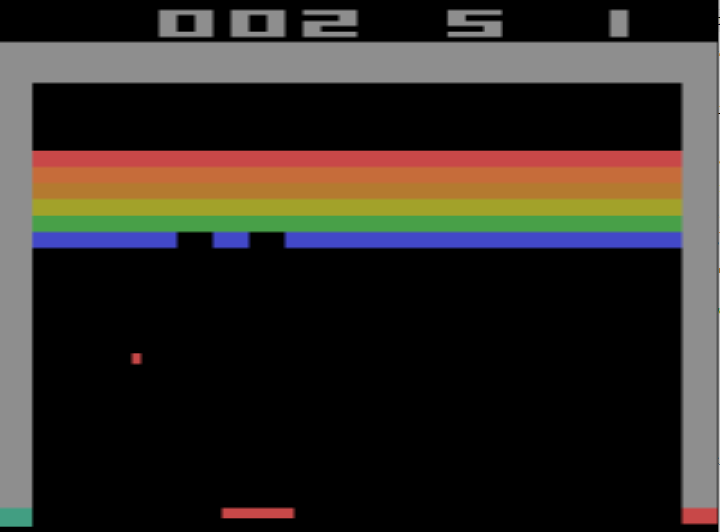
Movement
Which direction is the ball moving?
FIT5226 S2 2024
Week-5

Slide 22
Encoding Motion
Accurate control needs motion information,
Use multiple frames
Reduce size of the input image by
Using greyscale,
Rescaling frame size to 84 x 84
FIT5226 S2 2024
Week-5

Slide 23
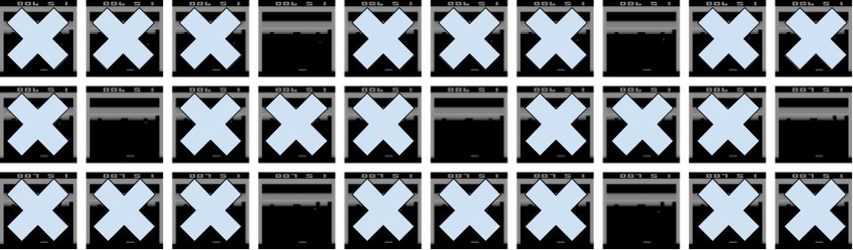
Subsampling
FIT5226 S2 2024
Week-5

Slide 24
2-dimensional input (spatial context)
By reducing input size we end up with 4 x 84 x 84 = 28,224 pixels
Flattening these into an input layer is possible, but loses spatial context
Solution: use Convolutional Neural Networks
FIT5226 S2 2024
Week-5

Slide 25
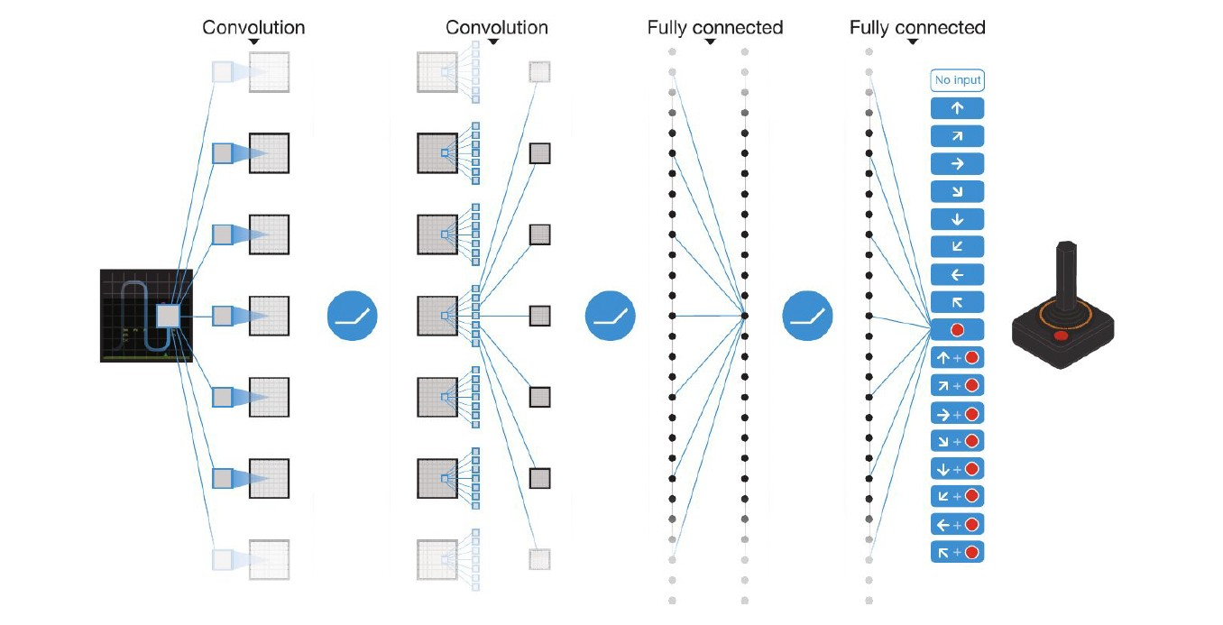
Q-Network Structure
s = 4 x 84 x 84 grayscale input,
32 filters of 8x8 with stride 4,
64 filters of 4x4 with stride 2,
64 filters of 3x3 with stride 1,
Fully connected, 512 units
Fully connected, |A|=18 output
FIT5226 S2 2024
Week-5

Slide 26
Advanced Deep-RL Methods
DQN (2013)
Double DQN
Duelling DQN
Prioritized Replay
Multi-step returns
Distributional Returns (C51)
Implicit Quantile Nets (IQN)
Rainbow (2018)
Munchausen RL (M-IQN; 2020)
And many more algorithms from other base algorithms, like deep policy gradients, actor critics
FIT5226 S2 2024
Week-5

Slide 27
Take home lessons
•
Large state spaces, continuous state spaces and generalisation require function approximation
•
We can use neural networks to approximate the state(action) value function
•
Deep-Q = Q-Learning + (DNN substitutes Q-Table)
•
the loss is calculated as difference to the TD-target
•
Experience replay is required to improve learning
•
Dual networks are required to avoid catastrophic forgetting
•
Adding Noise helps to avoid “Dead neurons”
•
Deep-Q is only just the beginning …
FIT5226 S2 2024
Week-5

